Slide 1



Amazon Best Selling Books Analysis Using Machine Learning

Slide 3
Introduction
What is the Project About?
Analyzing Amazon’s bestselling books to identify trends, patterns, and success factors.
Using machine learning to predict future bestsellers and derive actionable insights.
Why This Topic?
Amazon is a dominant book retailer; understanding success factors benefits authors, publishers, and readers.

Slide 4
OBJECTIVES
Identify trends in bestselling books.
01
Predict books likely to become bestsellers.
02
Analyze user sentiments and reviews.
03
Provide personalized recommendations.
04

Slide 5
Problem Statement
Identifying Success Factors
Predicting Bestseller Potential
Customer Review and Sentiment Analysis
Seasonality and Trend Analysis
Segmentation of Bestselling Books

Slide 6
methodology
Dataset Description
Source
bestsellers with categories.csv
Features
Name,Author,User Ratings,Reviews,Price,Year,Genre

Slide 7
METHODOLOGY
Machine Learning Algorithms
Chosen Machine Learning Algorithms
Linear Regression
Logistic Regression
Random Forest
K-means Clustering
Decision Tree

Slide 8
Methodology
Application of Evaluation Metrics
Accuracy
RMSE

Slide 9
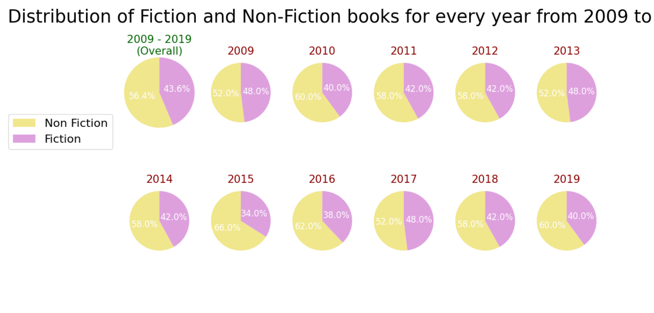
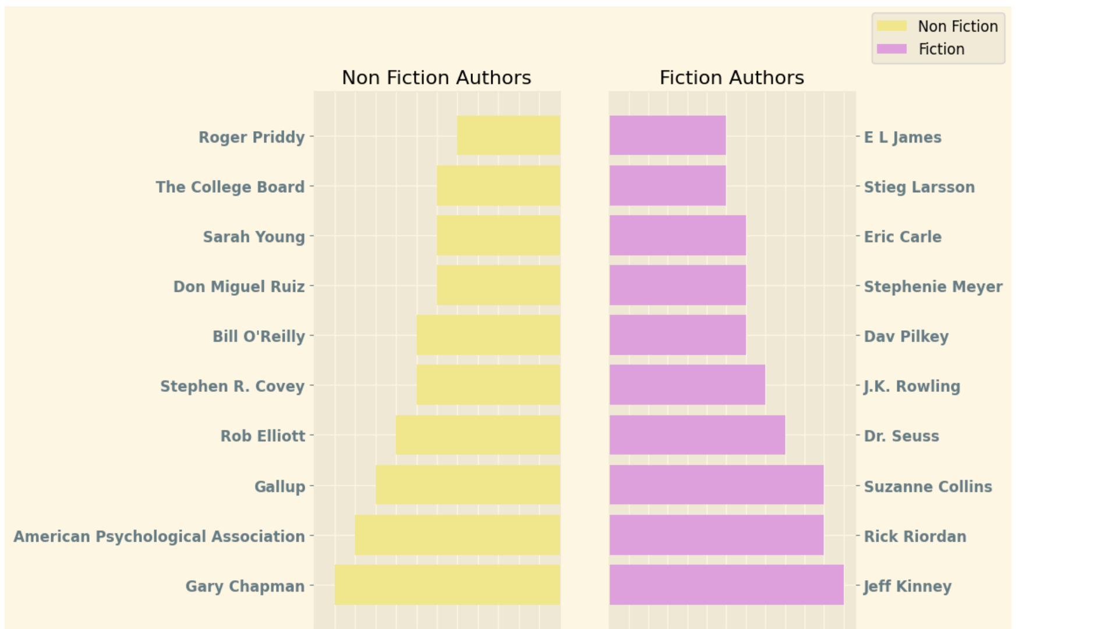
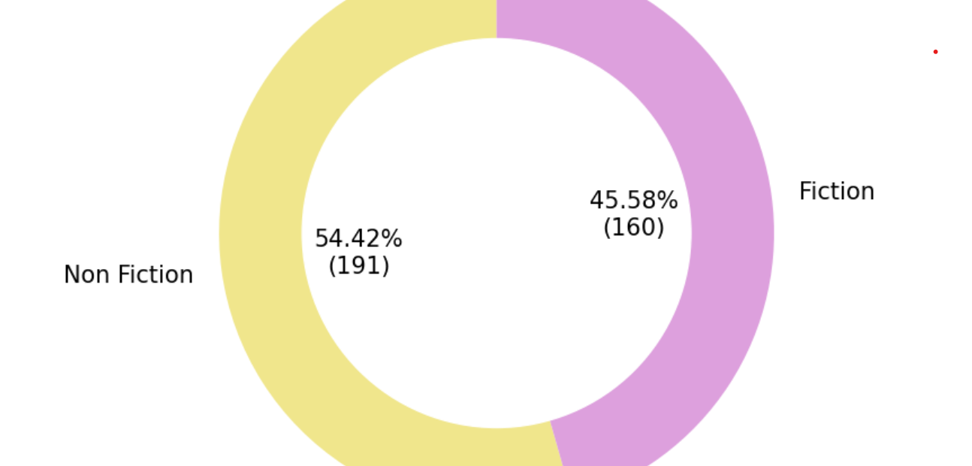
Data visualization

Slide 10
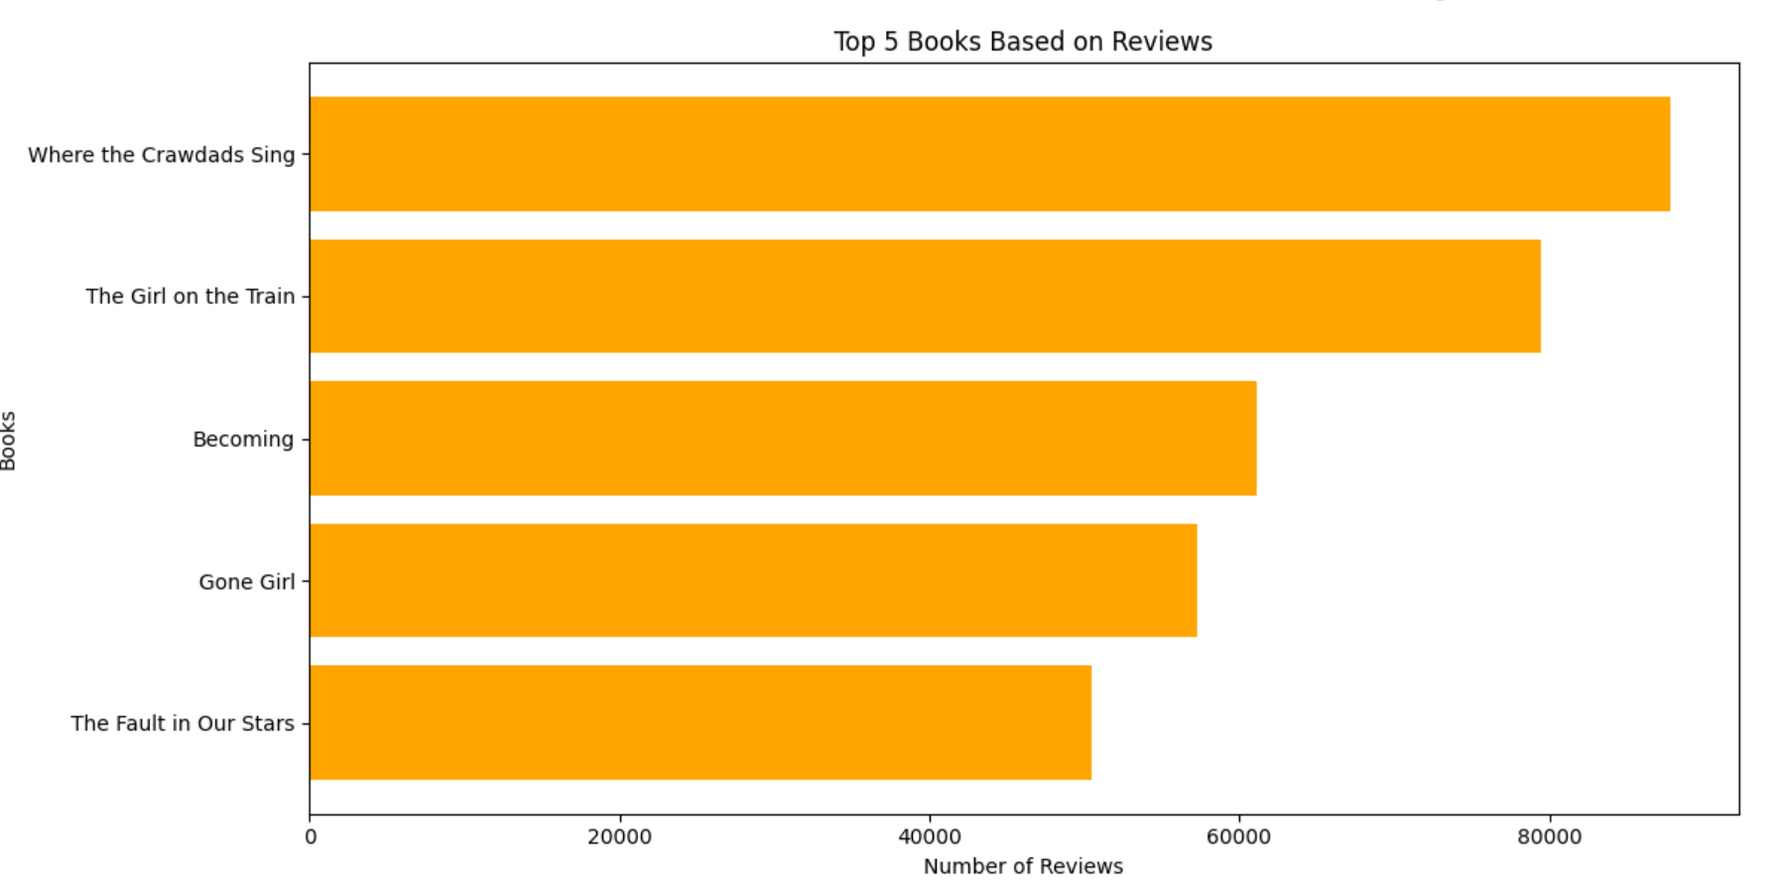
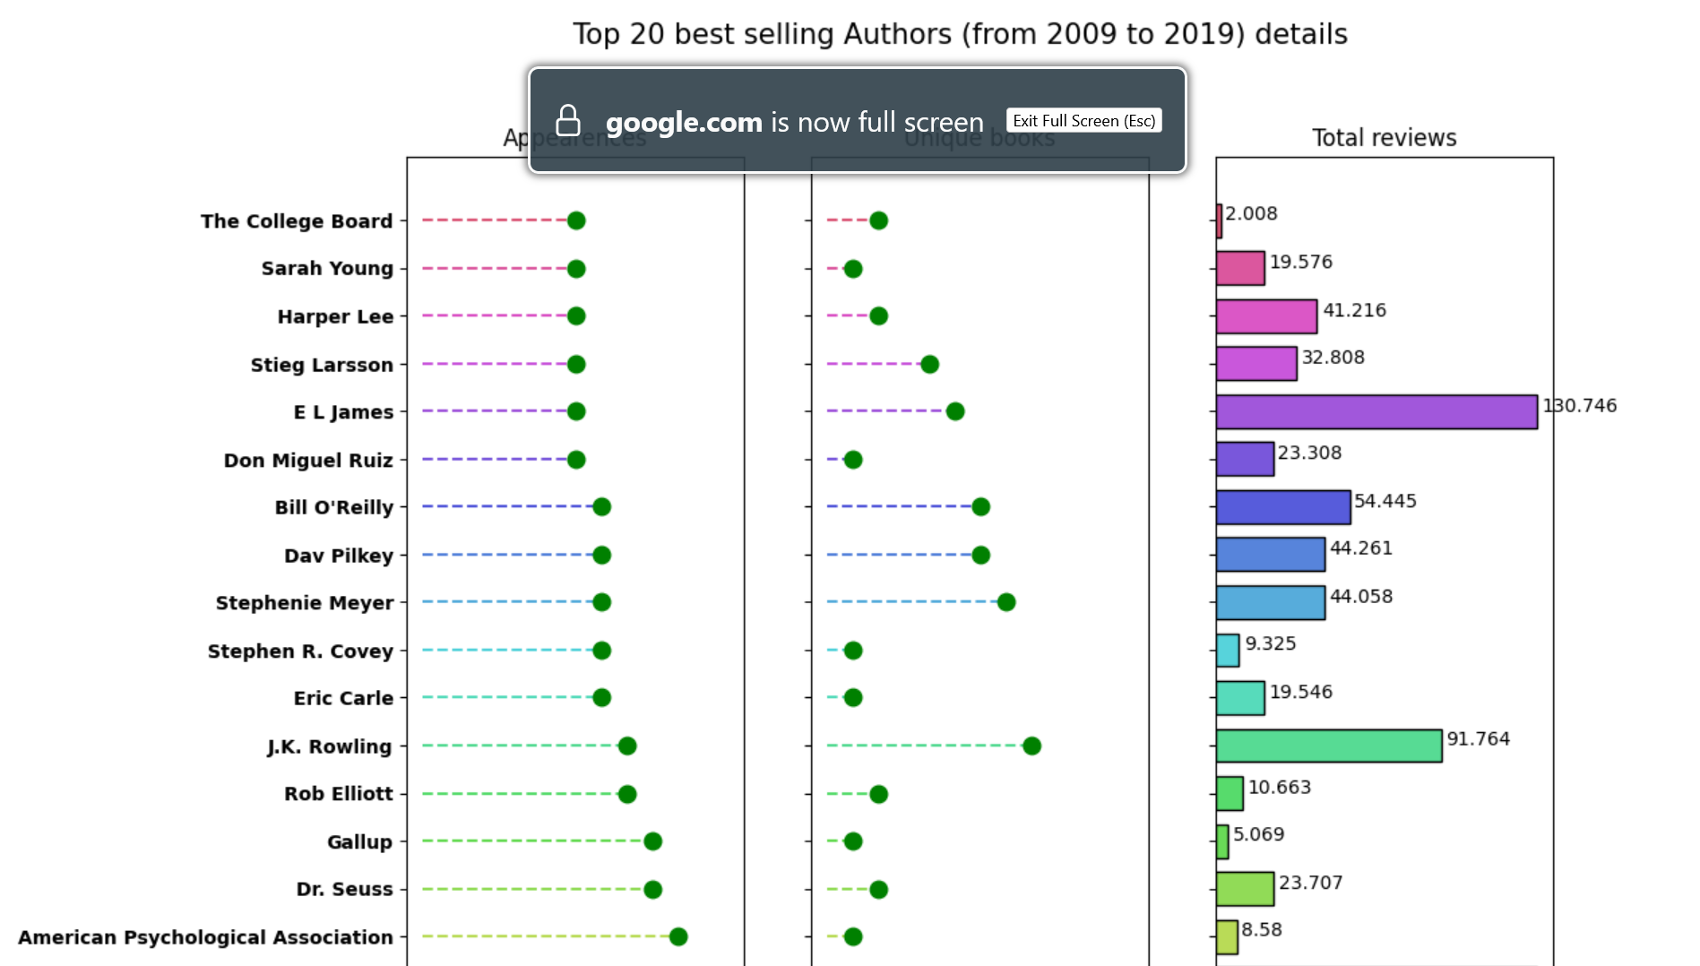
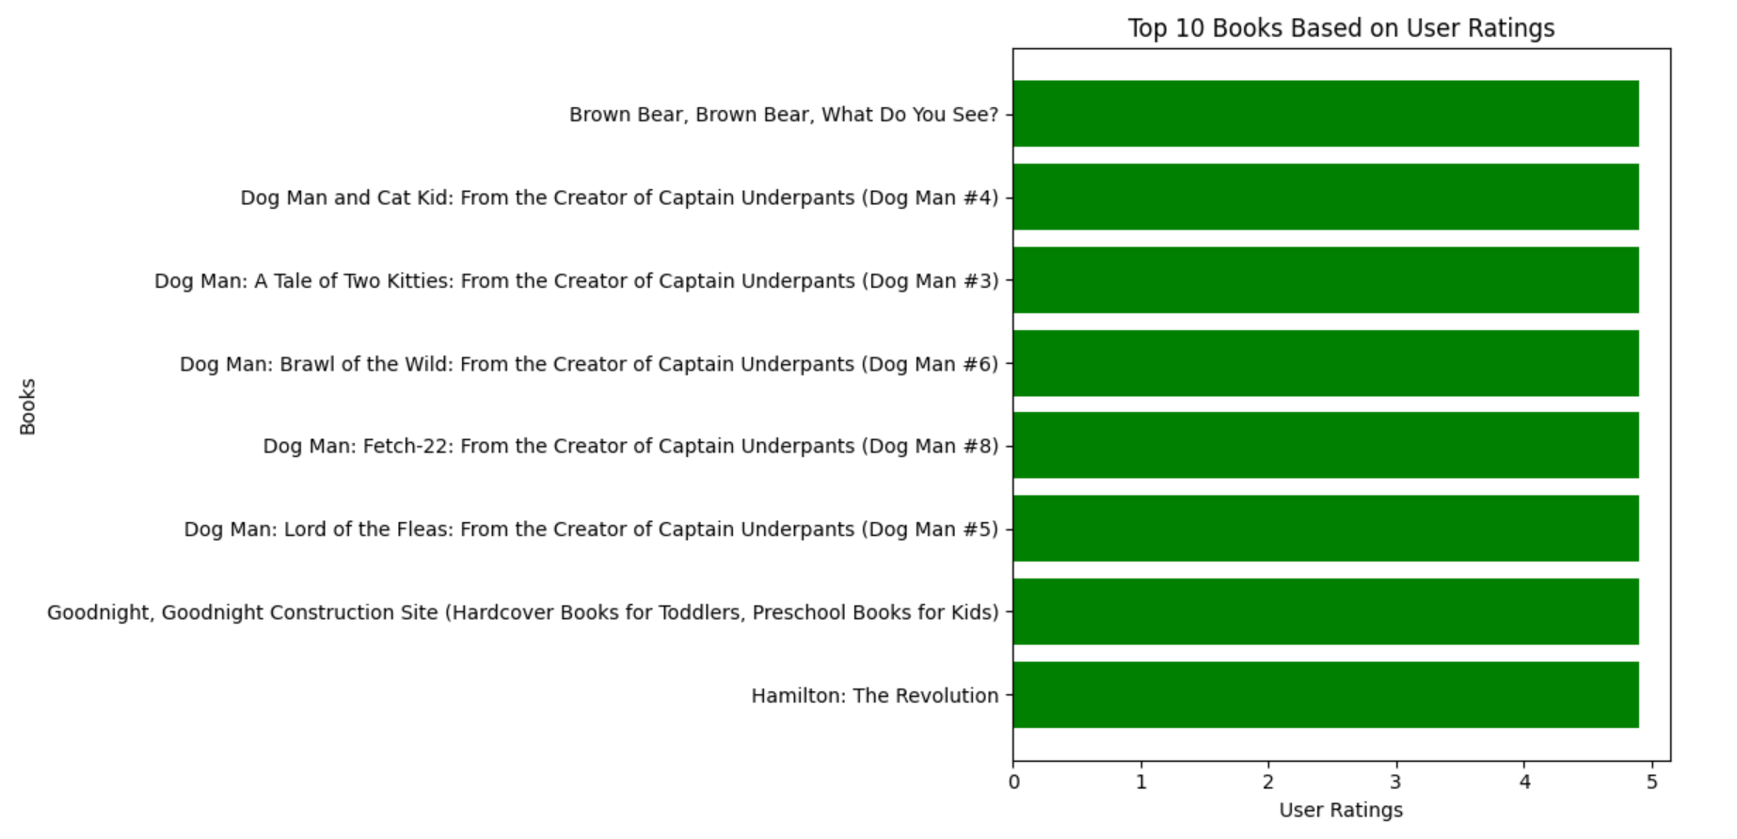
Data visualization(contd.)

